Slide 1
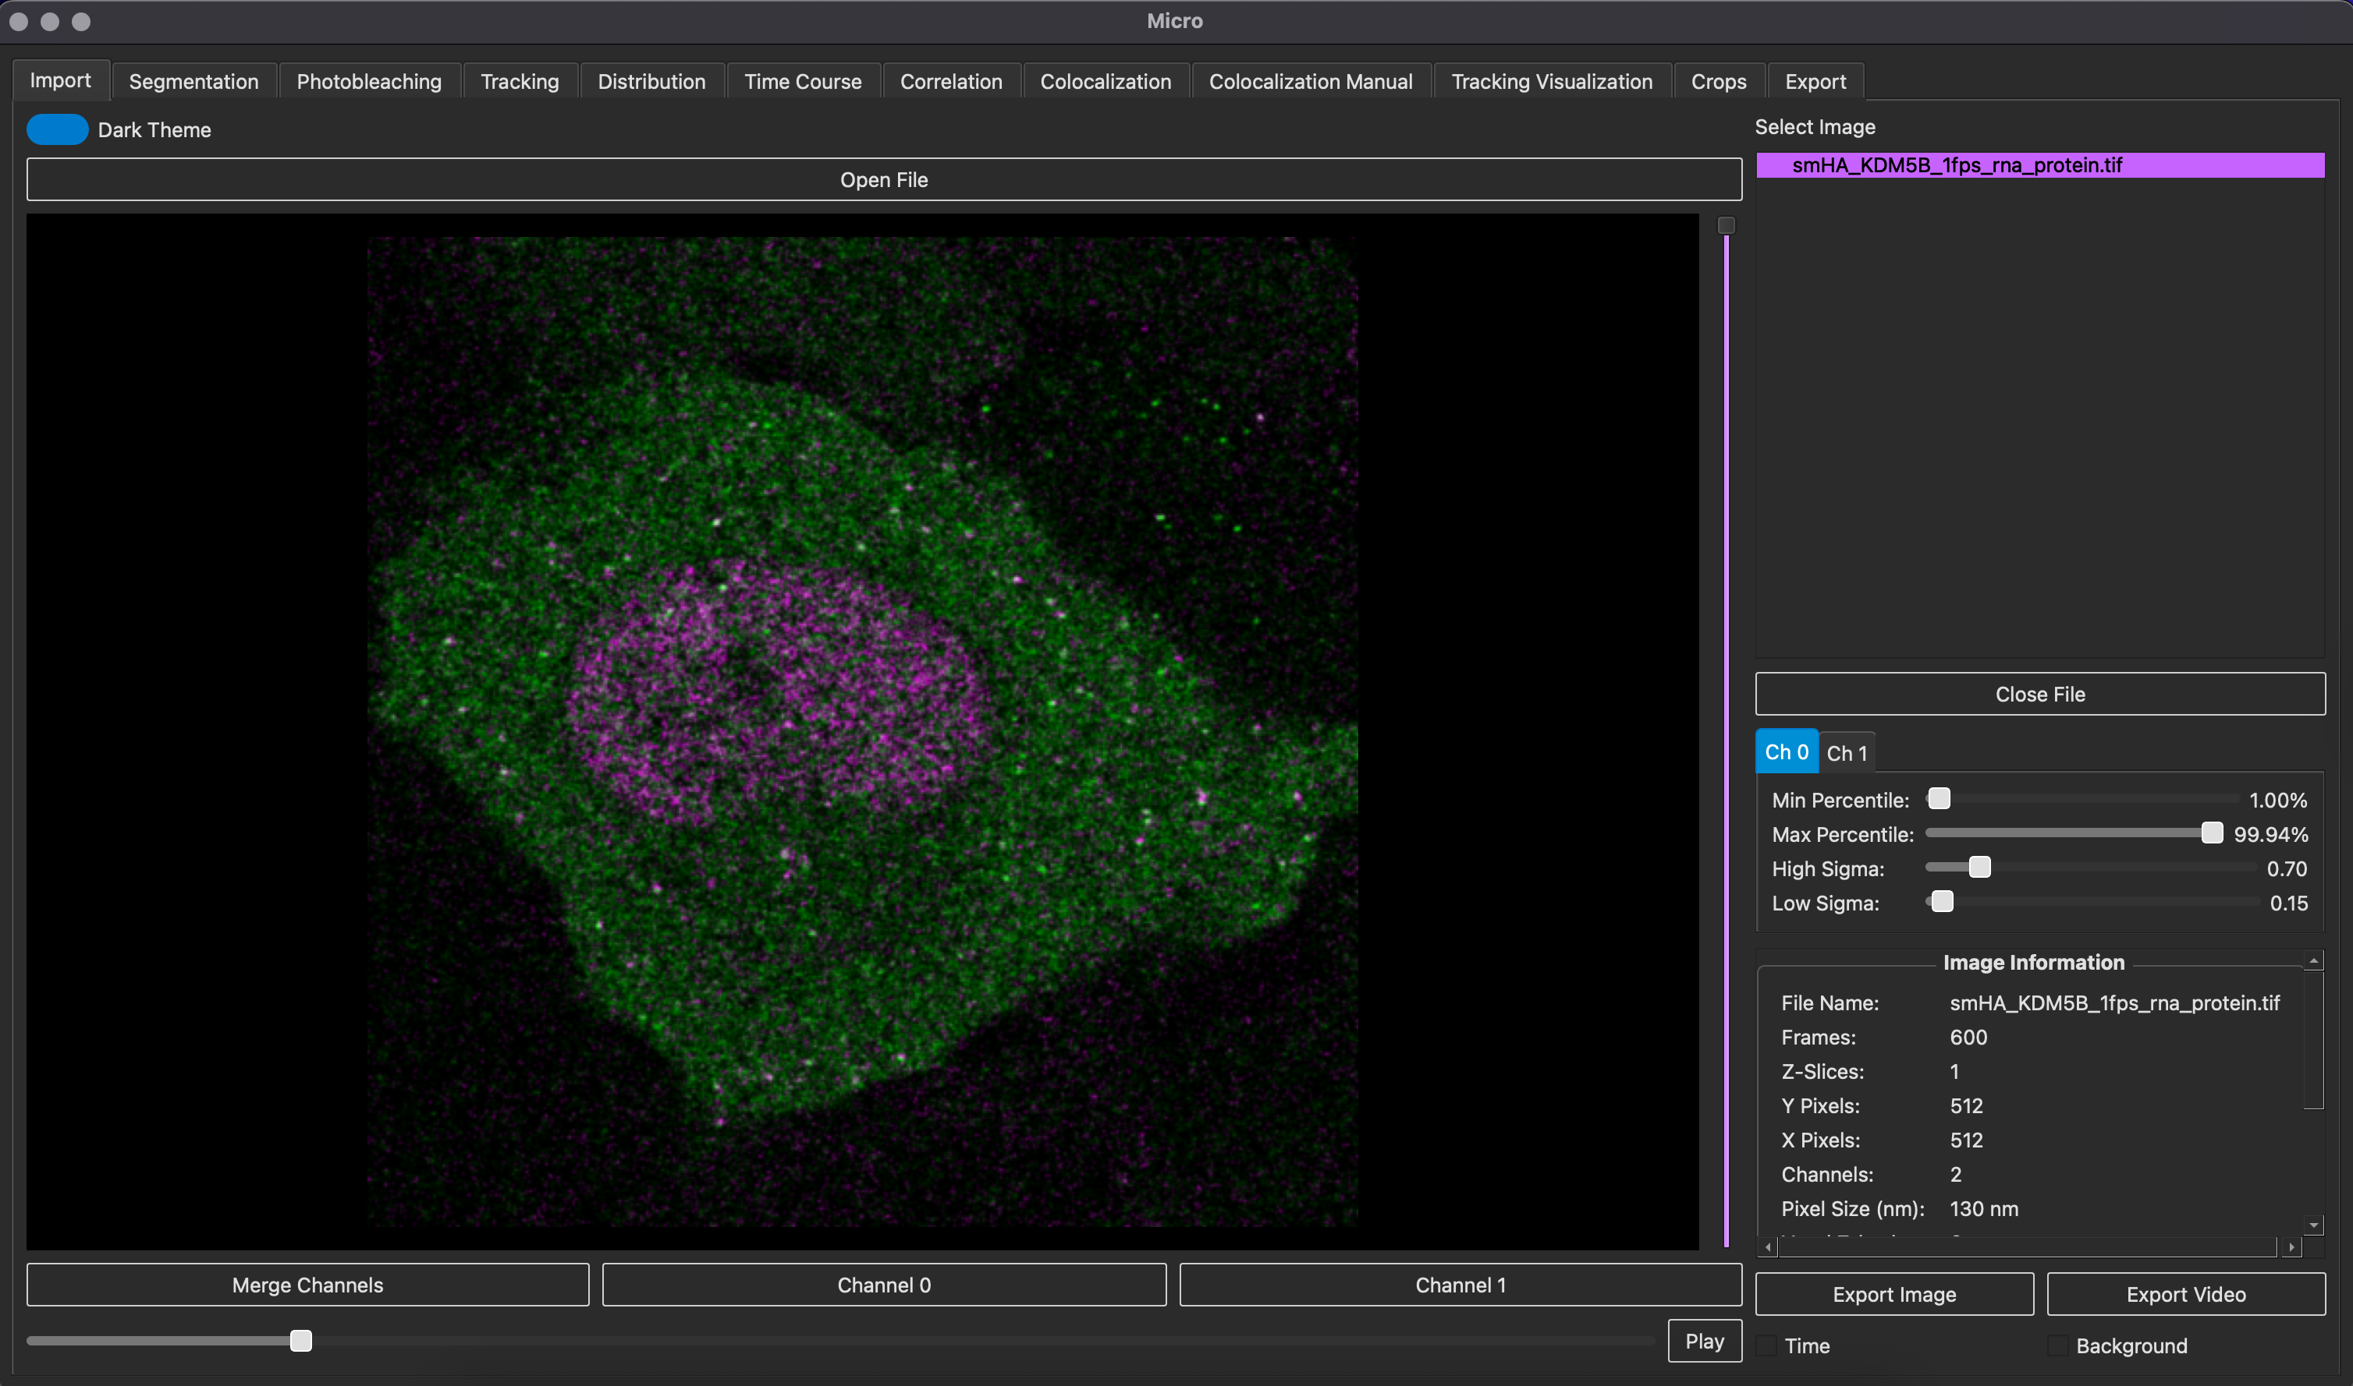
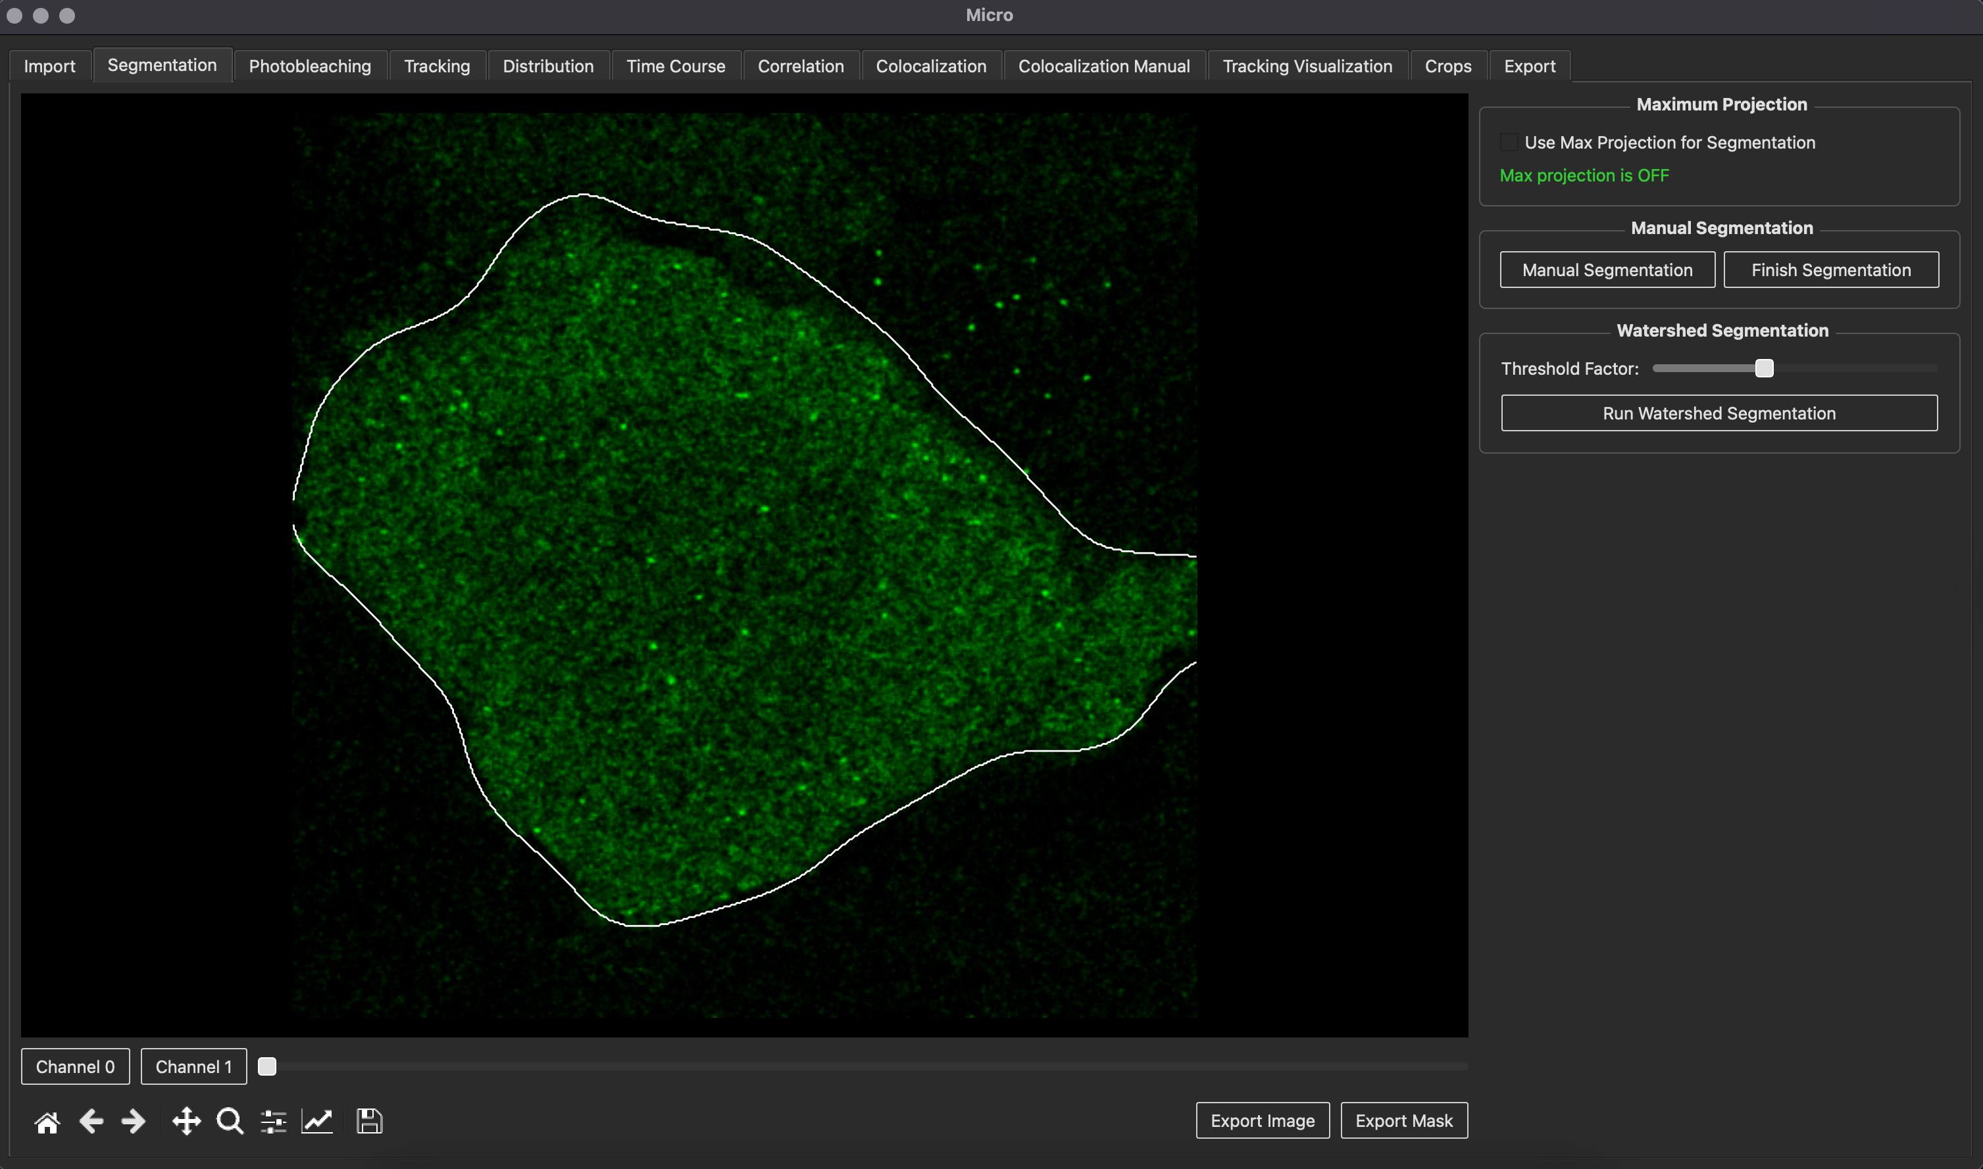
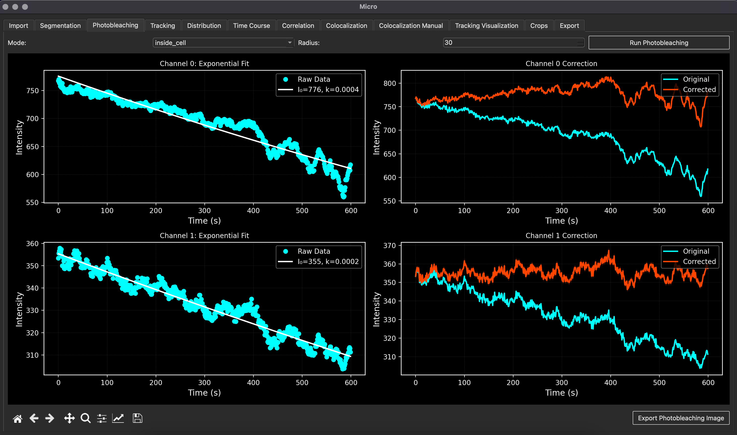
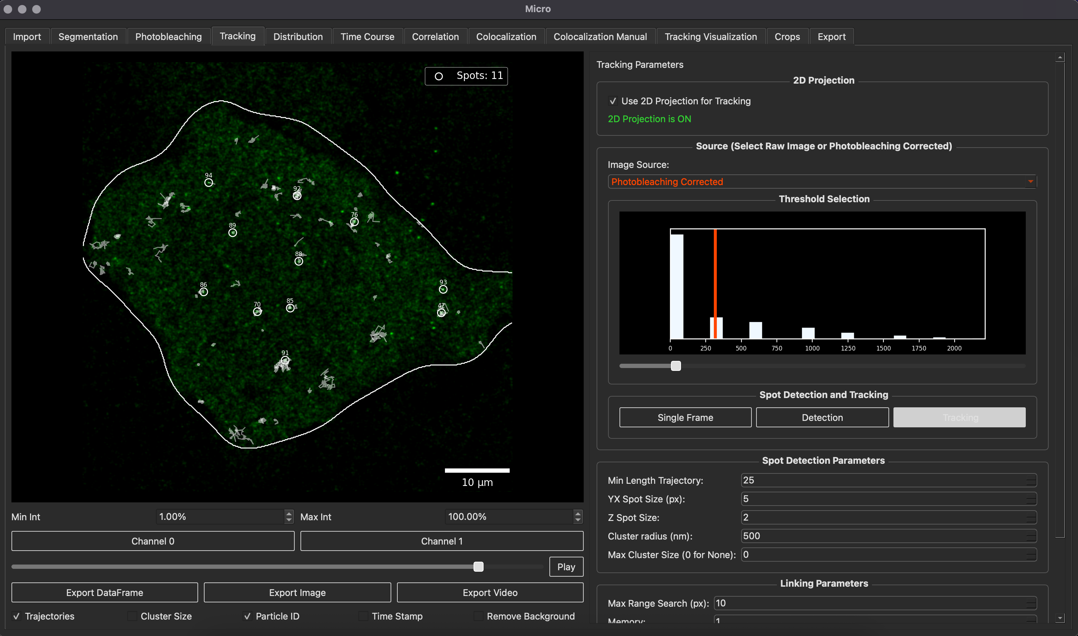
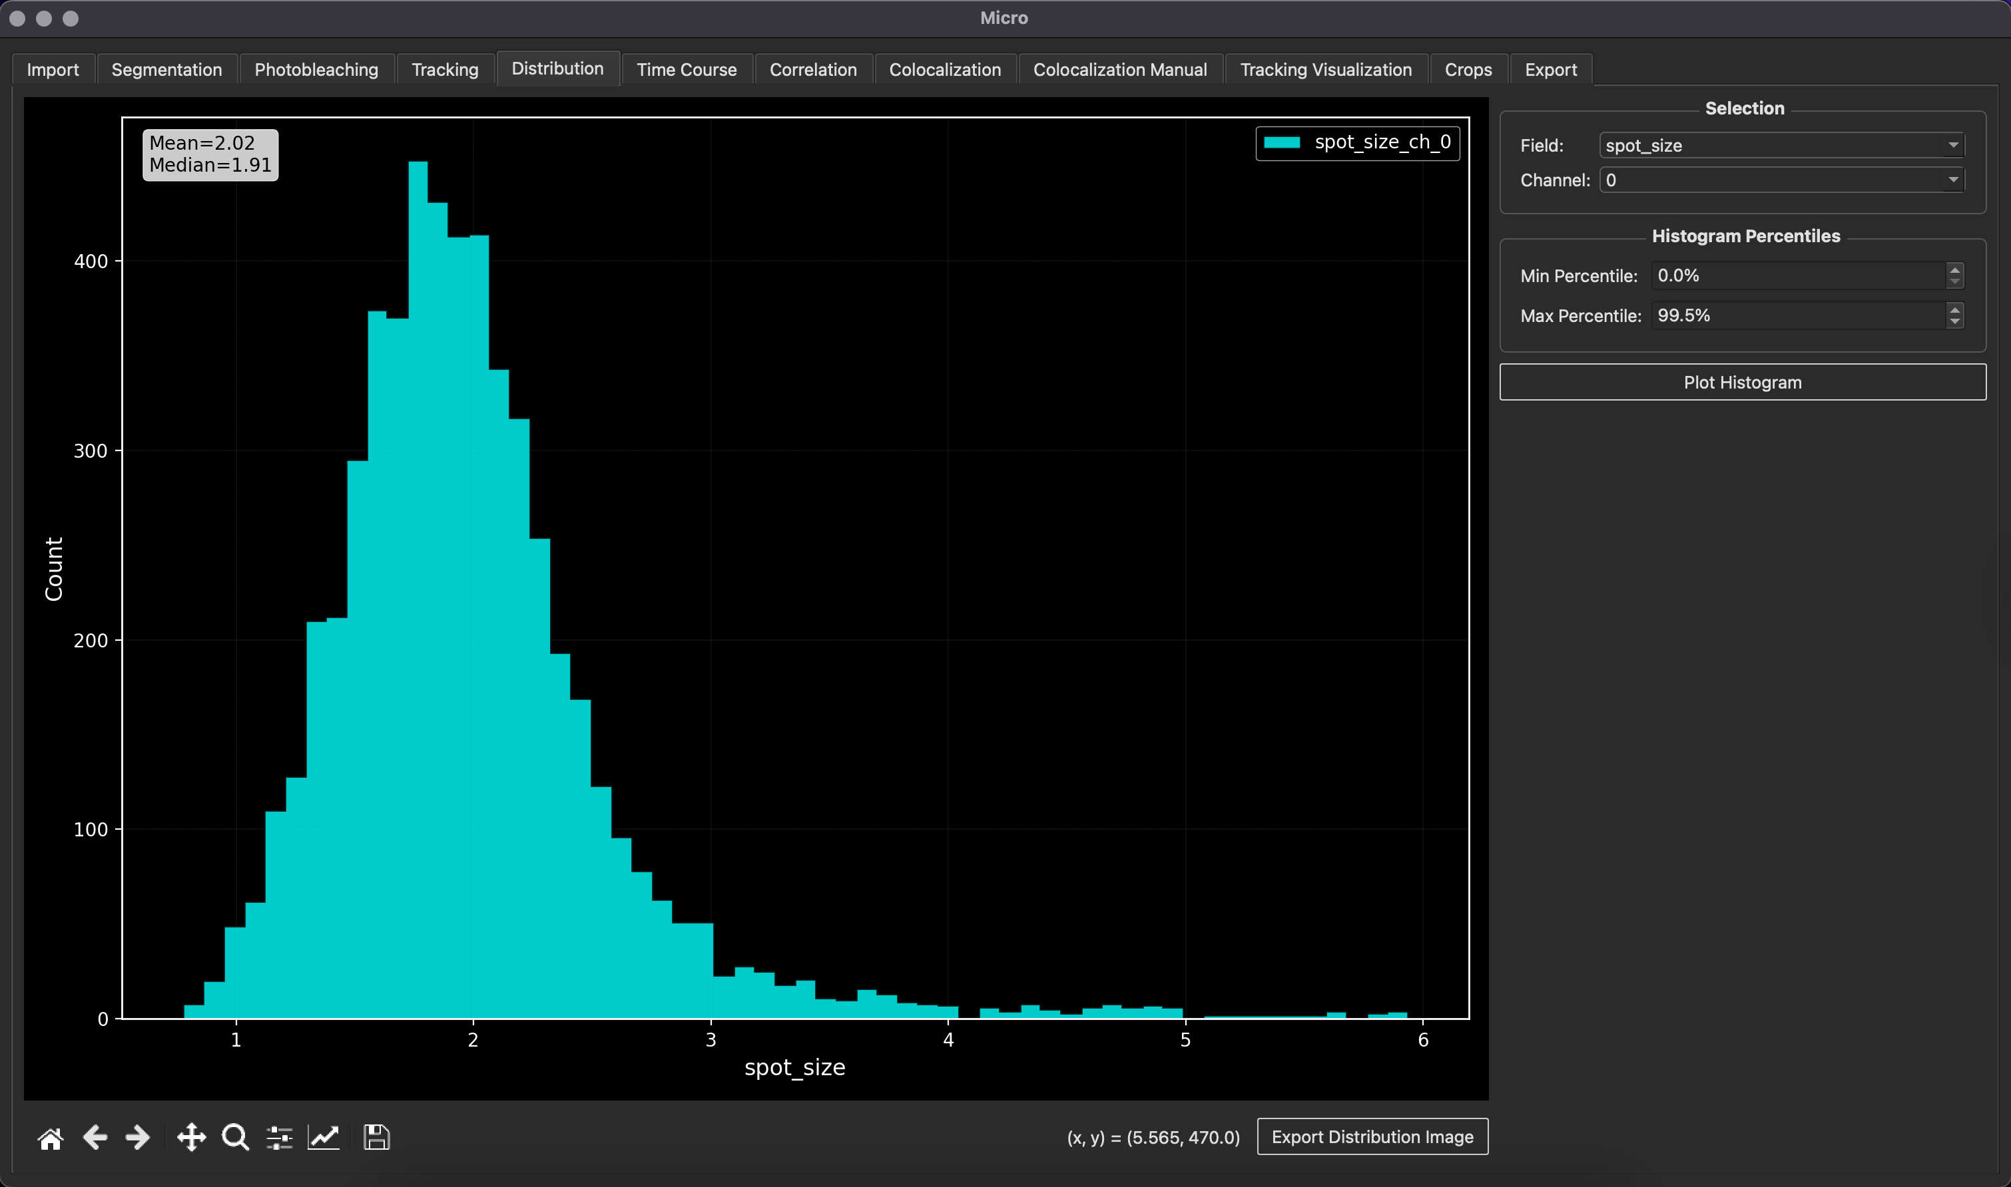
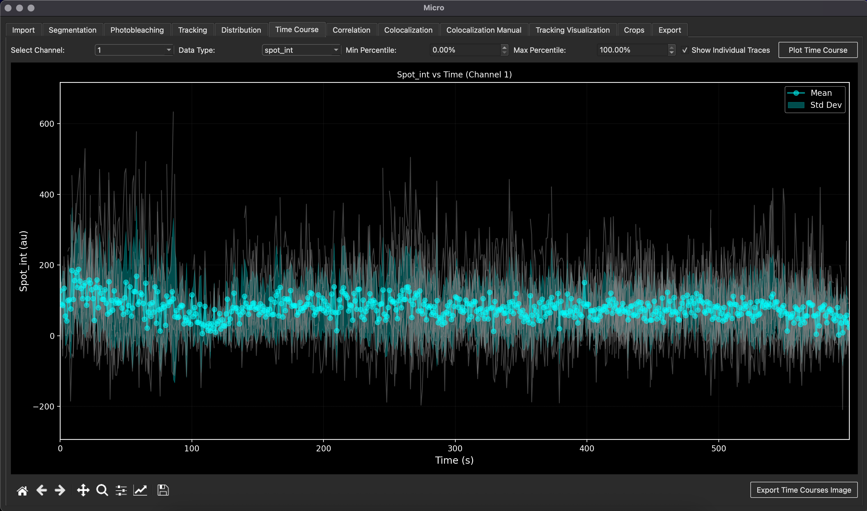
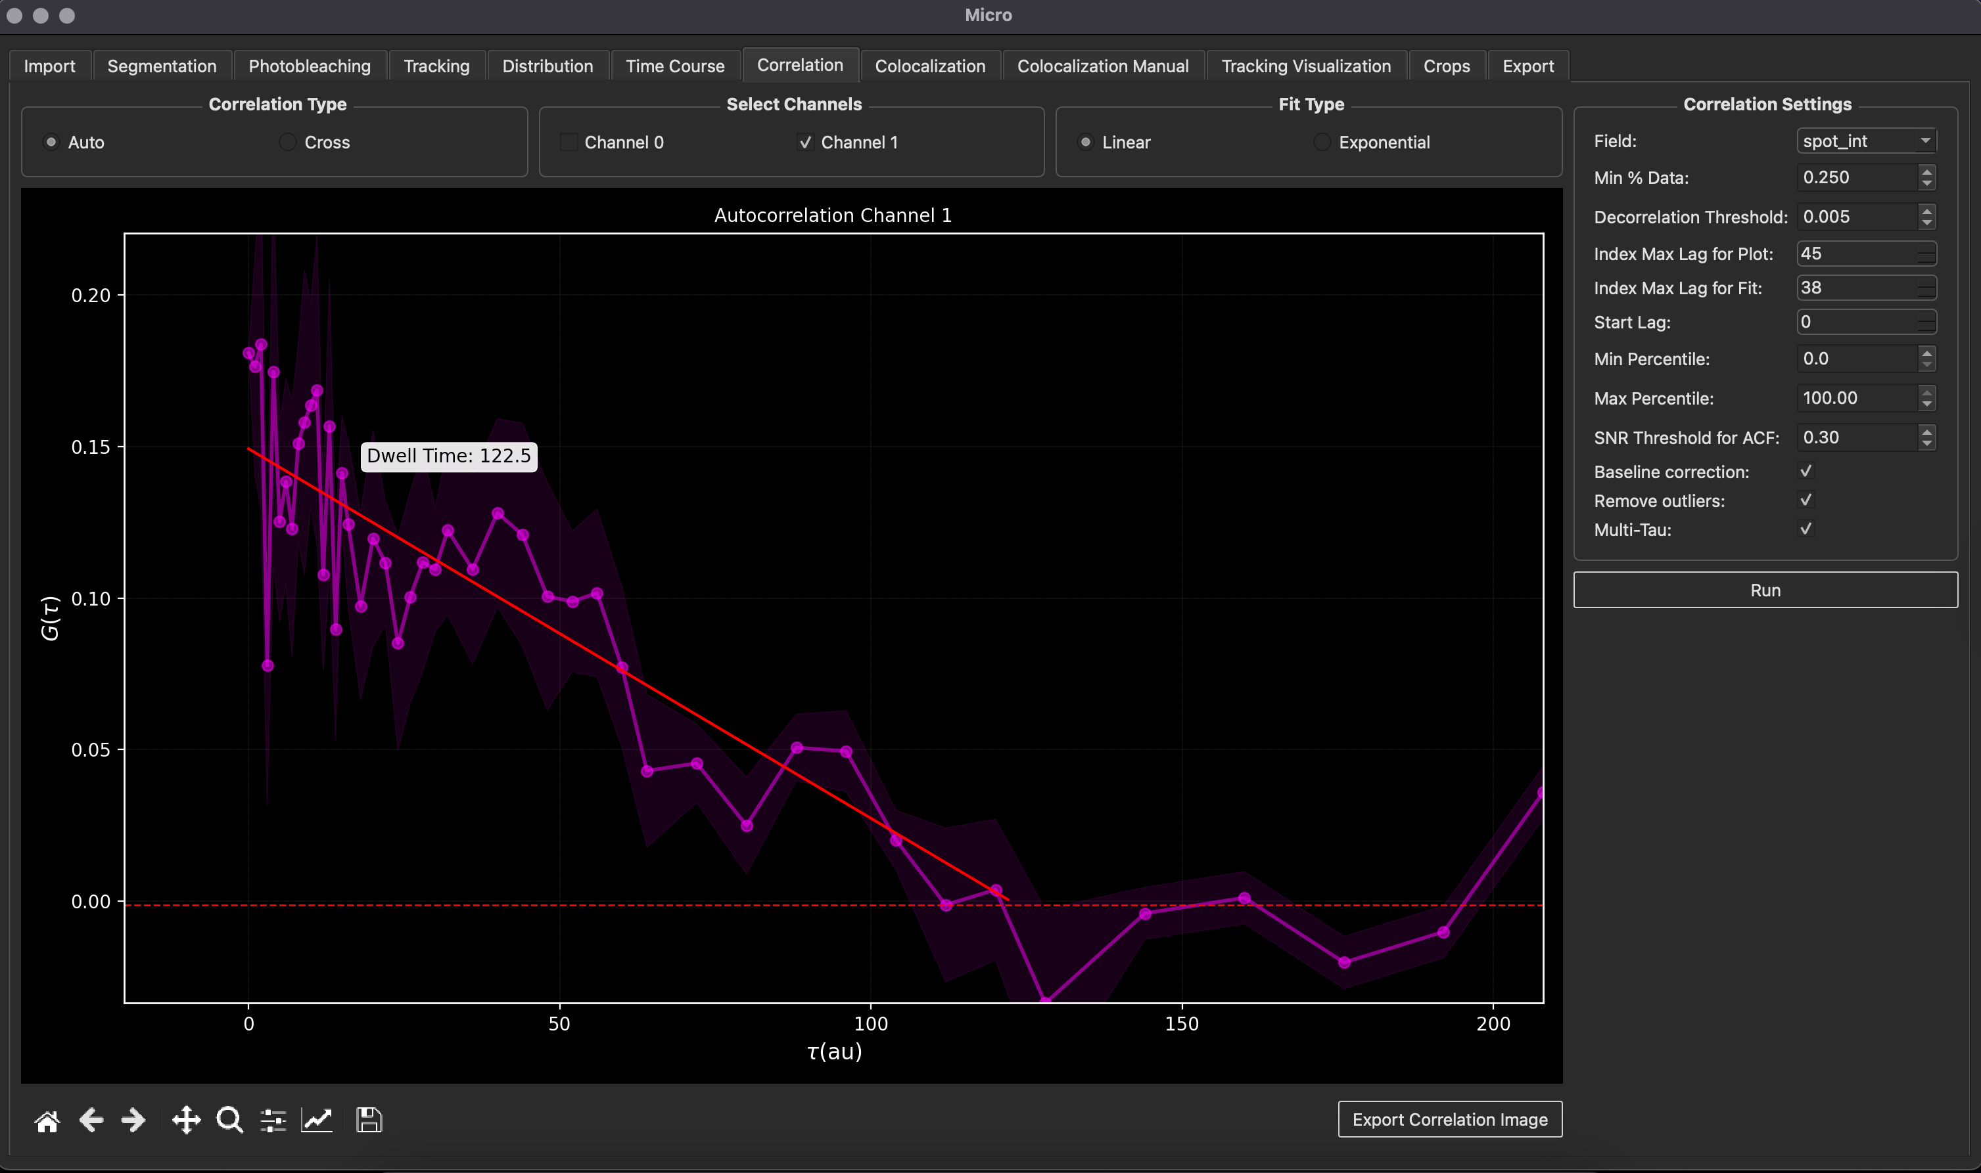
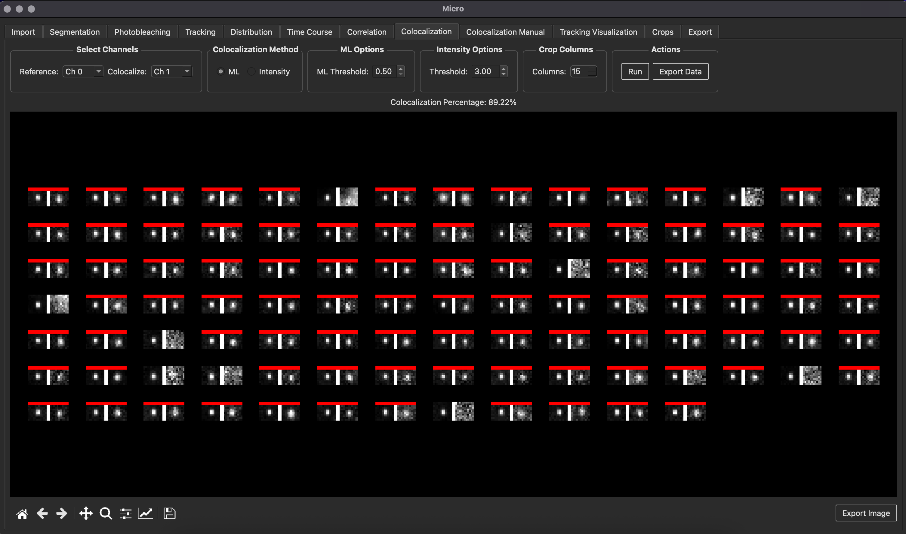
A) Original Image
B) Cell segmentation
C) Photobleaching correction
D) Particle tracking
E) Spot properties (size)
F) Time courses
G) Autocorrelation Function
H) Colocalization analysis

Slide 2
MicroLive
Utilities
Preprocessing
Detection
Statistical
Visualization
Import
Segmentation
Tracking
Correlation
Crops
Export
Photobleaching
Time Course
Distribution
Tracking Visualization
Colocalization
Colocalization
Manual

